Slide 1

Enhanced Notepad++ Text Editing Tools for MCNP Input Decks
13 July 2021
Micah Jeroutek, MS Student
Darren Holland, Research Assistant Professor
Air Force Institute of Technology

Slide 2
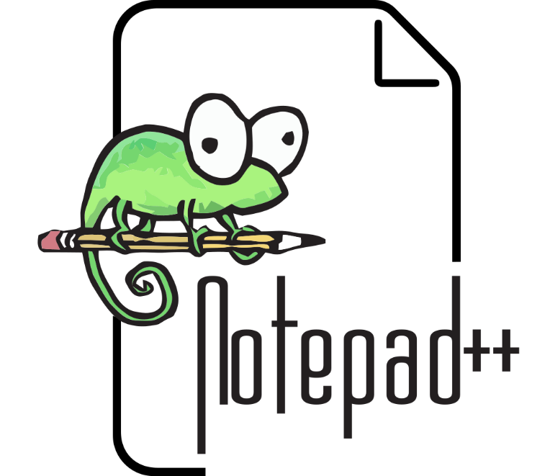
Text Editing for MCNP with Notepad++
No free text editor incorporates MCNP’s unique commands and syntax on Windows-based machines
Currently, Notepad++ is the most versatile and accessible Windows text editor
Notepad++ is a free source code editor
Features syntax highlighting for many different coding languages (Java, Fortran, Python, etc.)

Slide 3
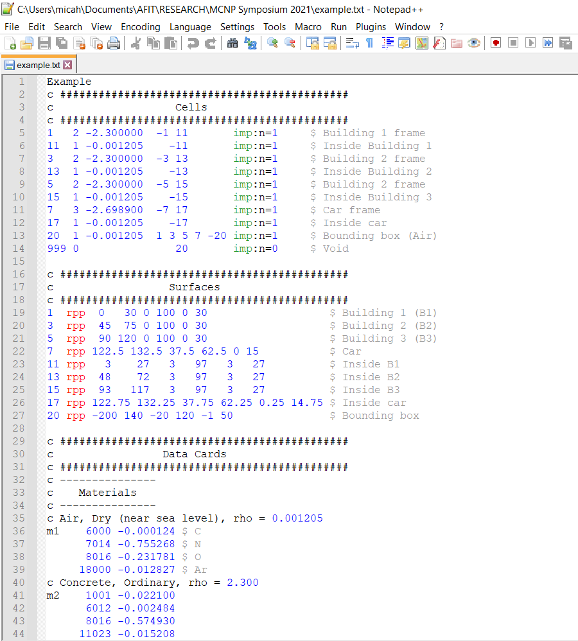
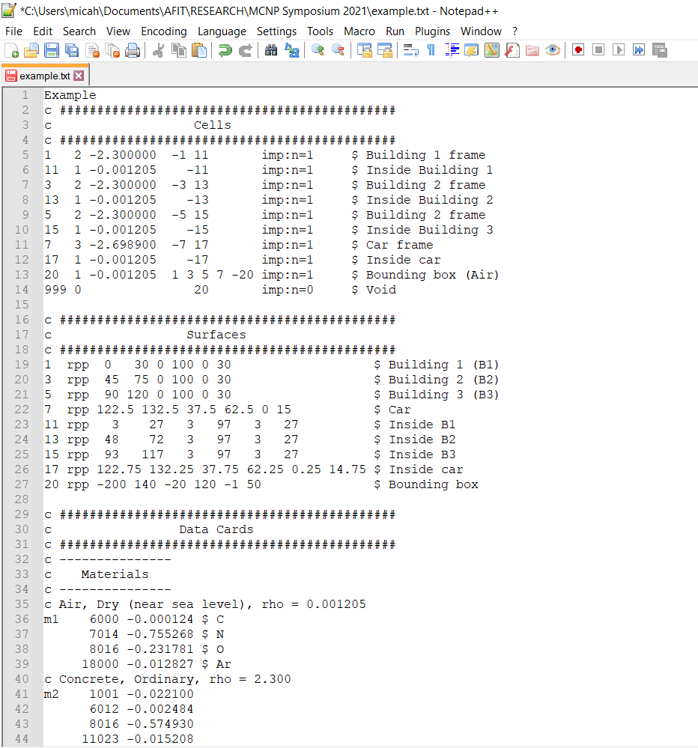
Relies on Notepad++ UDL
Makes use of Notepad++’s User Defined Language (UDL) feature
Adds syntax highlighting for MCNP input decks in real time

Slide 4
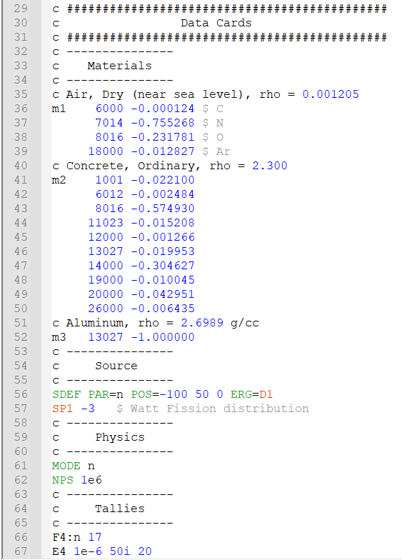
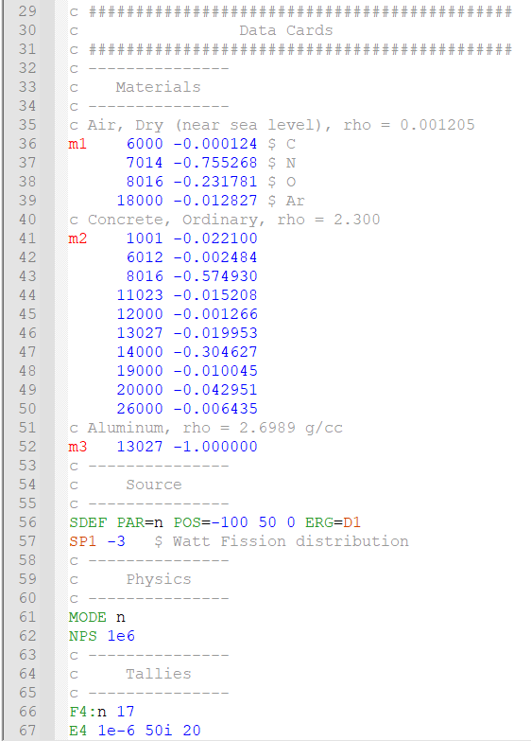
Adding Features with Python Script Plugin
Some MCNP syntax cannot be handled natively within the Notepad++ UDL
With the PythonScript Notepad++ plugin, the MCNP_UDL_Enhanced.py script may be applied
This color-codes tallies, material cards, comment lines, etc.

Slide 5
Download Instructions
Download these files at: https://github.com/mjeroutek/MCNP-Syntax-Highlighting
To run the UDL:
Move MCNP_Formatting_v1.4.xml to your \AppData\Roaming\Notepad++\userDefineLangs folder
Click on the MCNP option under Notepad++’s Language tab
To run the MCNP_UDL_Enhanced.py script:
Install the PythonScript plugin with Notepad++’s Plugins Admin tool
Move the script to /Program Files/Notepad++/plugins/PythonScript/scripts
In the Plugins dropdown, select Python Scripts, Scripts, and then MCNP_UDL_Enhanced

Slide 6
Questions
If you have any questions following this presentation, feel free to contact me at:
Work Email: micah.jeroutek@afit.edu
Personal Email: micah.jeroutek@outlook.com
Mobile Phone: +1 (865) 230-3960

